Slide 1
Car Finder
By David Grant, Andrew Kee, Rainier Gomez

Slide 2
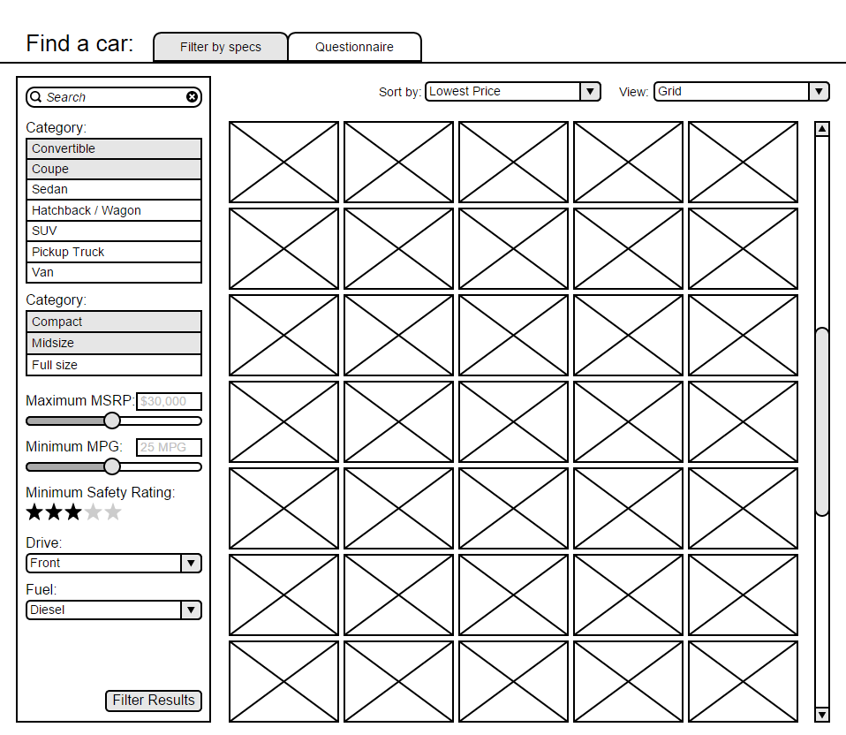
Project Description
Car buying is complicated
More info is better
Comparison sites are often cluttered, confusing, or incomplete
We wanted to make our own:
simpler and more useful

Slide 3
Demo
See it in action!

Slide 4
Division of Labor
David:
Main page front end
Main page Validation
Car data database structure
Car data retrieval and display
Andrew:
Accounts and sign in
CSS: a bit of polish
Rainier:
Sample data entry

Slide 5
Testing
Manual testing, no unit tests
Tested as it was written
All group members test, regardless of author
Tested in Chrome

Slide 6
Limitations
Cannot currently display all the data we have
No keyword search
No questionnaire
Only one view
Limited amount of data

Slide 7
Challenges
Accessing database from Javascript
Communication between group members
Github
Slack
Time
Project 6

Slide 8
Lessons Learned
Communication
Division of labor
Version control
Planning
Time management

Slide 9
The Future
Display more data
Keyword search
Questionnaire / Automated flowchart
More views: list view, detail view
More cars and more data about them
Side by side compare
Saving favorites

